Slide 1
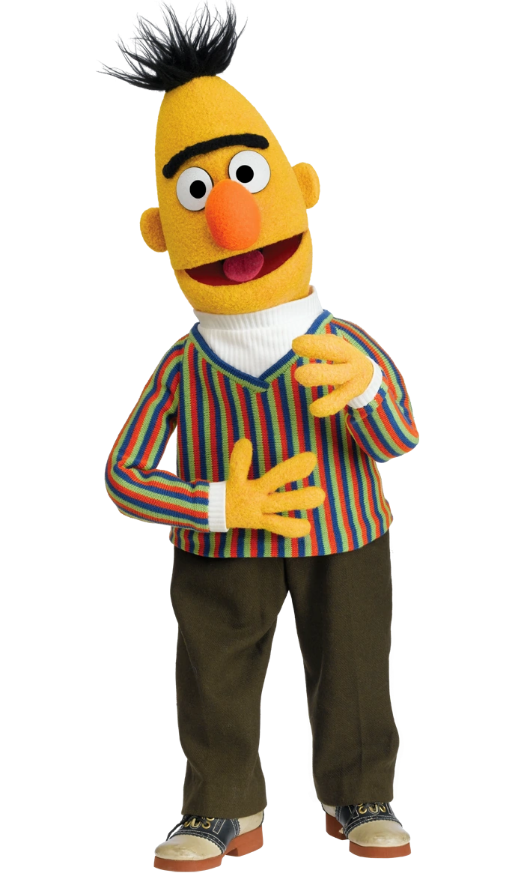


문장 유형 분류 AI 경진대회
제출수늘려주세요

Slide 2
개발환경
OS
windows 10
ubuntu 22.04
aws ec2 p3 2xlarge
라이브러리
torch 1.13.0
cuda 11.7.1

Slide 3
성능을 올리기 위한 시도
Text Augmentation
replaced 2 words in one sentence and made 2 or 3 sentences.(randomly)
Ensemble
Customize model layers
Residual Blocks
Change loss function
Focal Loss
Asymmetric Loss
(https://github.com/Alibaba-MIIL/ASL/blob/main/src/loss_functions/losses.py)
(https://paperswithcode.com/paper/asymmetric-loss-for-multi-label)
Fold(just 5 folds)
Huggingface Custom Trainer 🤗
Custom Scheduler (안썼습니다.)

Slide 4
앙상블 경로
740
.ipynb
741
.ipynb
743
.ipynb
744
.ipynb
749
.ipynb
7474
.ipynb
앙상블.ipynb
각 폴더의 숫자는 추론을 제출했을때의 Public Score 입니다.

Slide 5
사용한 사전학습모델과 출처
kykim/electra-kor-base
(https://github.com/kiyoungkim1/LMkor)
(https://huggingface.co/kykim/electra-kor-base)
(https://openreview.net/pdf?id=r1xMH1BtvB)
monologg/kobigbird-bert-base
(https://github.com/monologg/KoBigBird)
(https://huggingface.co/monologg/kobigbird-bert-base)
(https://arxiv.org/abs/2007.14062)
beomi/KcELECTRA-base-v2022
(https://github.com/Beomi/KcELECTRA)
(https://huggingface.co/beomi/KcELECTRA-base-v2022)
(https://openreview.net/pdf?id=r1xMH1BtvB)

Slide 6
자세한 사항은 소스를 봐주세요 !
감사합니다

